Slide 1

Psyliq- HR Data Analysis Assessment
VIPUL JAISWAL (DATA ANALYST INTERN)

Slide 2


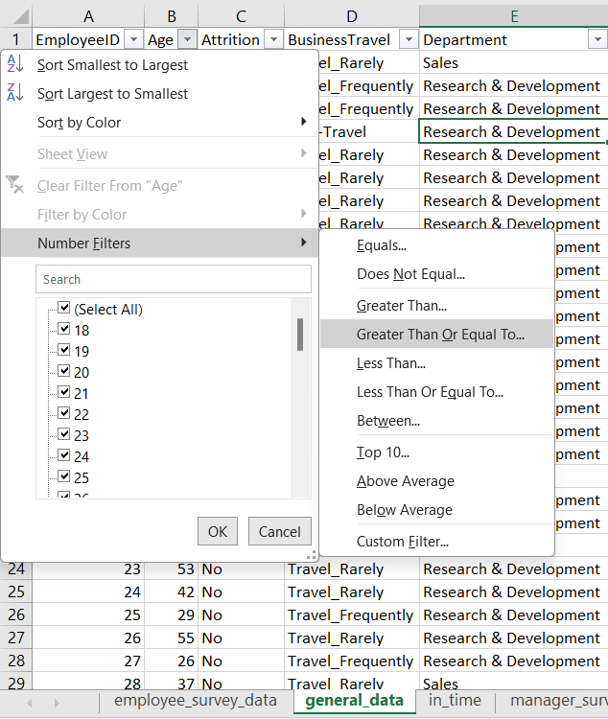
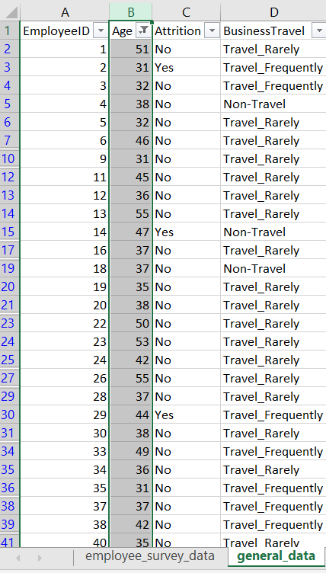

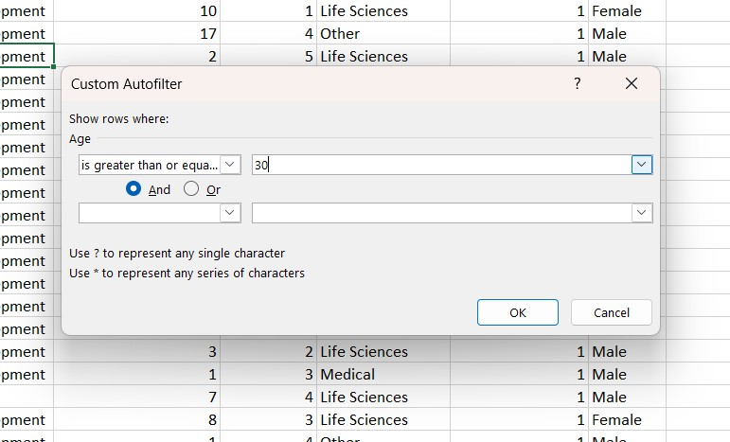
Using Excel, how would you filter the dataset to only show employees aged 30 and above?

Slide 3

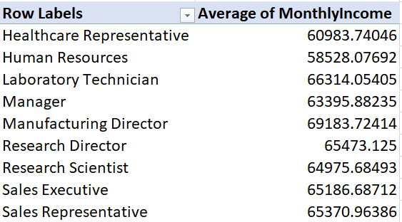
Create a pivot table to summarize the average Monthly Income by Job Role.

Slide 4

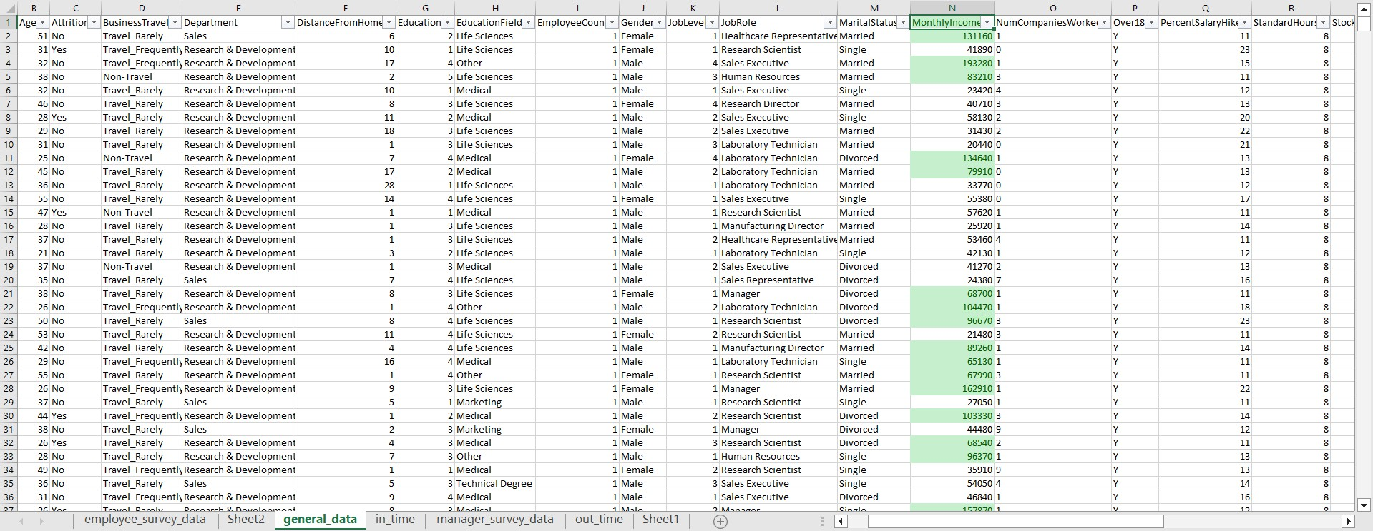
Apply conditional formatting to highlight employees with Monthly Income above the company's average income.

Slide 5
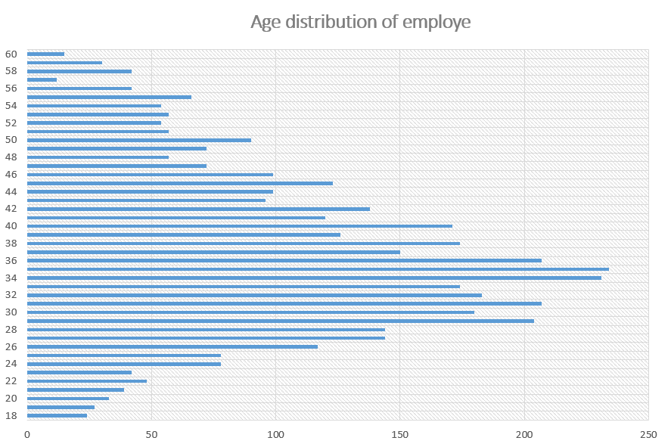
Create a bar chart in Excel to visualize the distribution of employee ages.

Slide 6

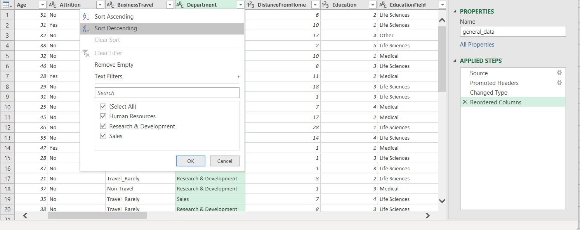
Identify and clean any missing or inconsistent data in the "Department" column.
There are neither missing nor inconsistent values in the ‘Department’ column to be cleaned.

Slide 7

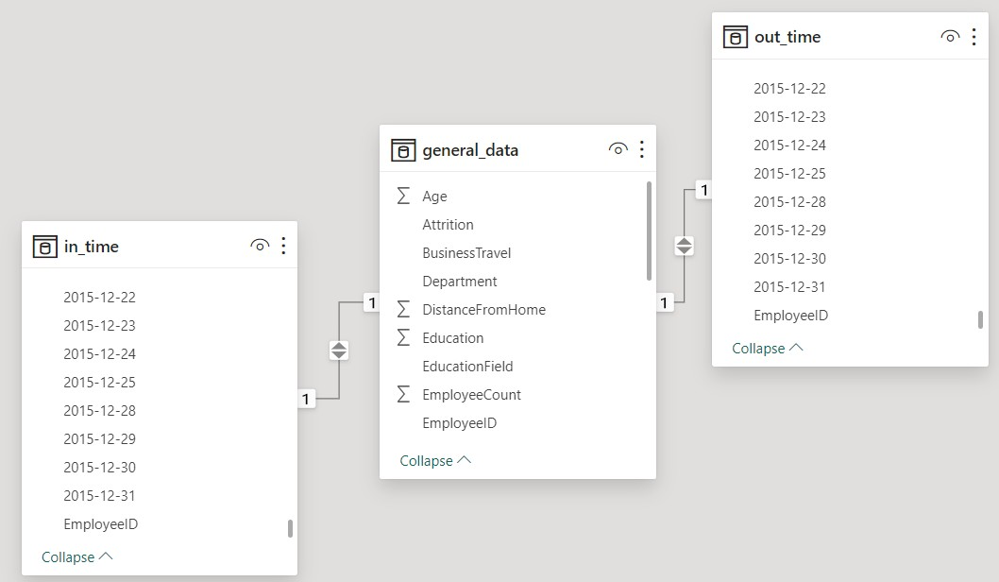
In Power BI, establish a relationship between the "EmployeeID" in the employee data and the "EmployeeID" in the time tracking data.

Slide 8

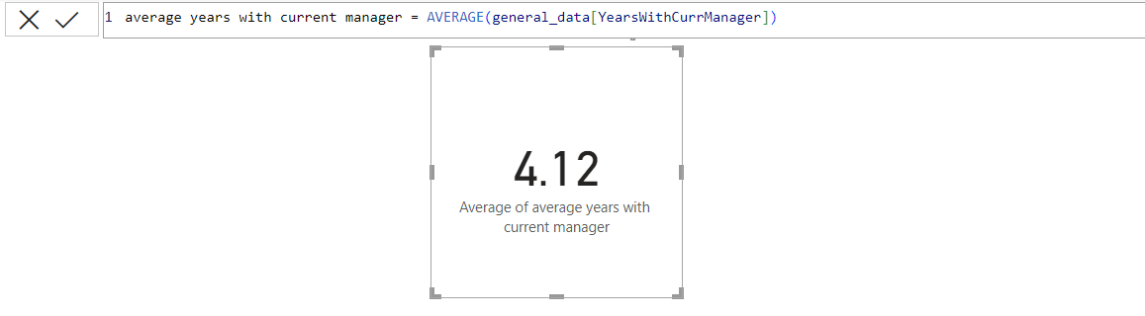
Using DAX, create a calculated column that calculates the average years an employee has spent with their current manager.

Slide 9

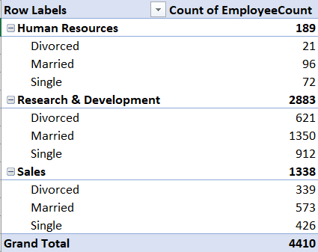
Using Excel, create a pivot table that displays the count of employees in each Marital Status category, segmented by Department.

Slide 10


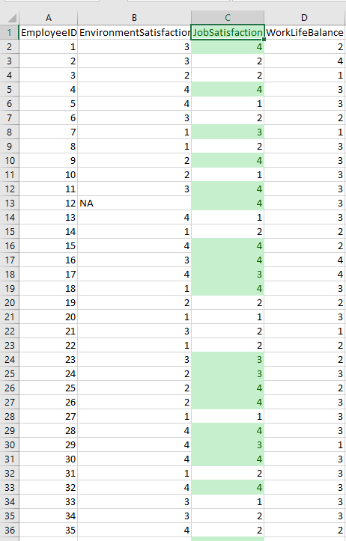
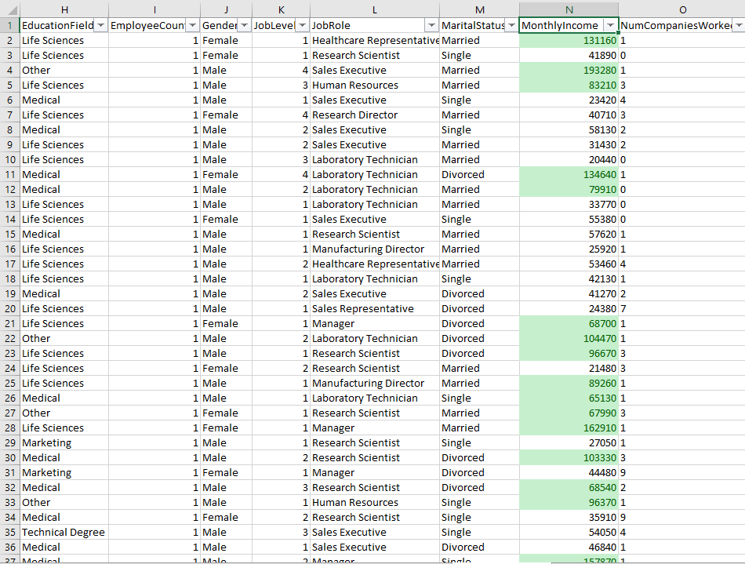
Apply conditional formatting to highlight employees with both above-average Monthly Income and above- average Job Satisfaction.
Above-average Job Satisfaction
Above-average Monthly Income

Slide 11

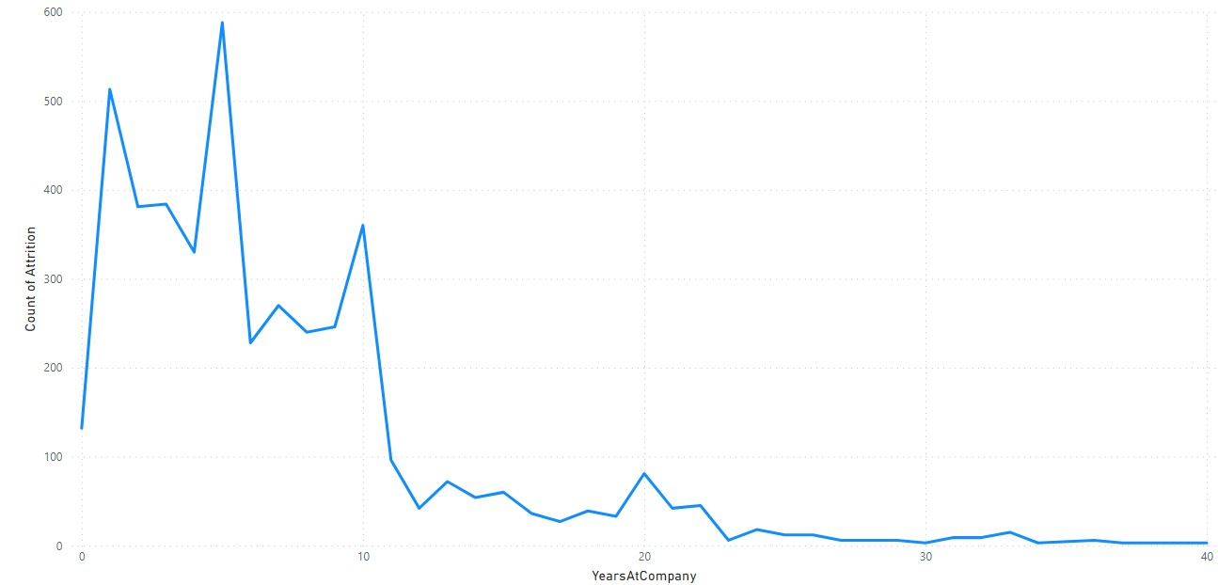
In Power BI, create a line chart that visualizes the trend of Employee Attrition over the years.

Slide 12
Describe how you would create a star schema for this dataset, explaining the benefits of doing so.
To create a star schema out of this dataset we would need 'Fact' and 'Dimensions' tables separated with appropriate columns and foreign keys, the general steps should be:
To normalize the table and divide it into more tables i.e. we may create 'Employee Attrition Fact Table', 'Satisfaction Fact Table', 'Job Performance Fact Table' which would be the center of the star schema.
Furthermore, we need Dimension tables as well consisting of 'Employee Dimension Table’, 'Satisfaction Dimension Table', 'Job Performance Dimension Table', 'In-Out Time Dimension Table’.
All these dimension tables would contain a primary key 'EmployeeID' which is connected to the foreign key 'Employee ID' of the Fact tables.
This ensures that the data is correctly related, and Power BI can perform accurate analysis and reporting.
The benefits of creating a star schema for this dataset would be:
Simplicity and Understandability for technical as well as non-technical users.
The separation of dimensions and facts allows for efficient querying, especially for aggregations and reporting.
The star schema is scalable and can handle large datasets and Star schemas are flexible and can adapt to changing reporting requirements.
Data redundancy is minimized in a star schema. Also, security can be managed more efficiently in a star schema since access controls can be implemented at the dimension and fact table levels.

Slide 13

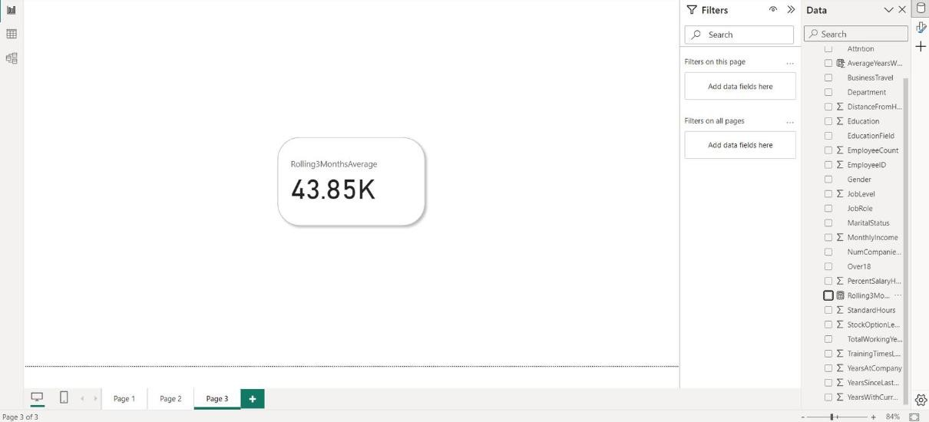
Using DAX, calculate the rolling 3-month average of Monthly Income for each employee.

Slide 14
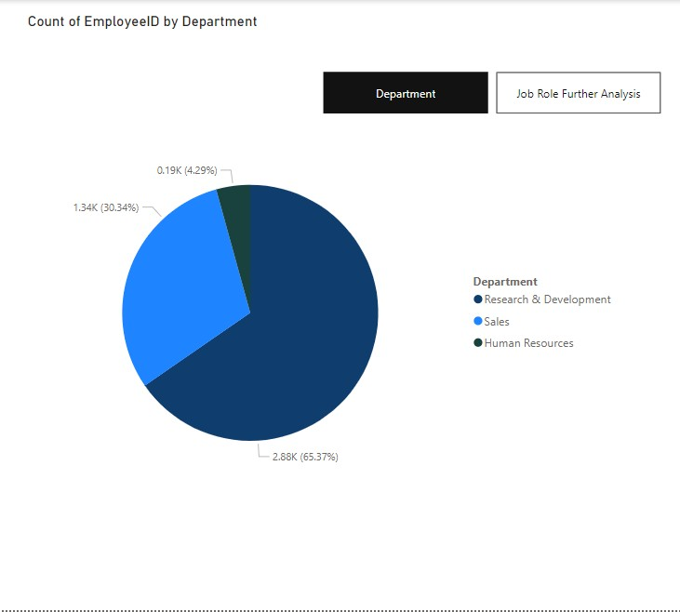
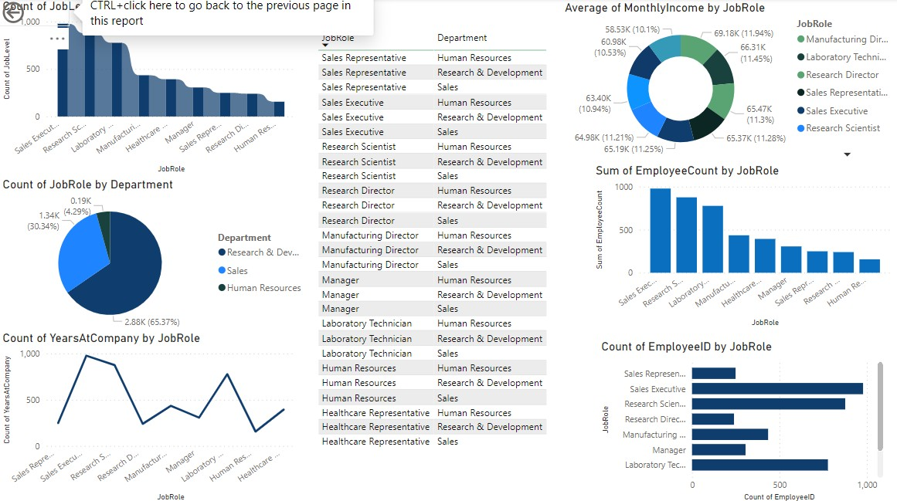
Create a hierarchy in Power BI that allows users to drill down from Department to Job Role to further narrow their analysis.

Slide 15
How can you set up parameterized queries in Power BI to allow users to filter data based 2 of 2 on the Distance from Home column?
Parameterized queries can be set up using Power Query, to allow users to filter data based on the Distance from Home column using parameters.
Load your data, create a new parameter in the Power Query Editor for Distance Parameter, and set its datatype to decimal/whole number.
In the Power Query Editor, locate the query that loads your data and add a filter step to filter the data based on the parameter. = Table.SelectRows(YourPreviousStep, each [DistanceFromHome] <= DistanceParameter)
Click "Close & Apply" in the Home tab to apply the changes.
In your Power BI report, create a slicer visual or any other method for users to input the parameter value and manually update the filter condition in your visual to reference the parameter.

Slide 16

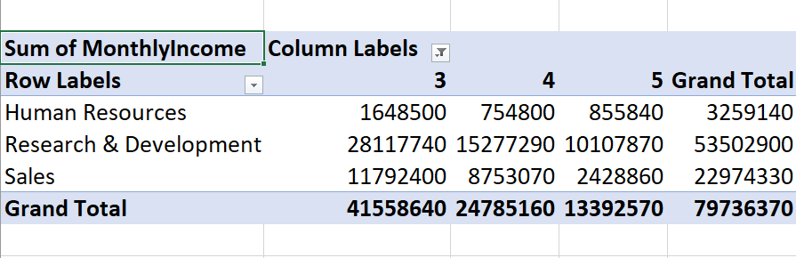
In Excel, calculate the total Monthly Income for each Department, considering only the employees with a Job Level greater than or equal to 3.

Slide 17
Explain how to perform a What-If analysis in Excel to understand the impact of a 10% increase in Percent Salary Hike on Monthly Income.
To perform a What-If analysis:
In a cell (let's say A1), enter the initial Percent Salary Hike value (e.g., 5%), or else, highlight the cells where the percent hike is stored.
In another cell, calculate the Monthly Income based on the formula that includes the Percent Salary Hike.
Now that you have both the columns 'Monthly Income' and 'Percent Salary Hike', drag down the cell with the initial Percent Salary Hike to, say, A10. Excel will fill in the remaining values.
We can see how Monthly Income changes with different Percent Salary Hike values.
Likewise, you can also go to Data Tab in Excel and click on 'What-If analysis' and select 'Data Table’.
Choose the cell with the formula for Monthly Income as the "Column input cell" and play with different Percent Salary Hike values, and Excel will show you the corresponding Monthly Income.

Slide 18
Verify if the data adheres to a predefined schema. What actions would you take if you find inconsistencies?
Verifying if data adheres to a predefined schema involves checking whether the actual data in a dataset aligns with the expected structure and rules outlined in the predefined schema.
As per current status of the data, there is a need to reorder EmployeeID column, changing data type of 'TotalWorkingHours' column, flling NA values and blank values from general_data, employee_survey_data, manager_survey_data.
There is 'EmployeeID' label missing in the 'in-time' and 'out-time' data.
It is very important to address these inconsistencies in the data files and check if data profiling is done carefully and the data is validated correctly.
The dataset would then conform to the predefined schema following the resolution of all identified inconsistencies and the implementation of necessary data quality measures.

Slide 19
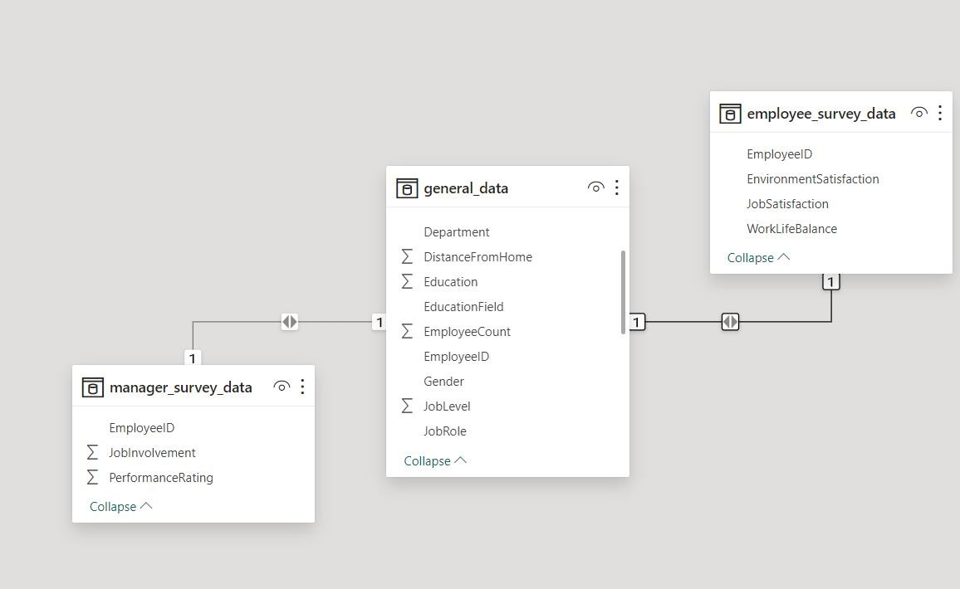
DASHBOARD MODEL

Slide 20
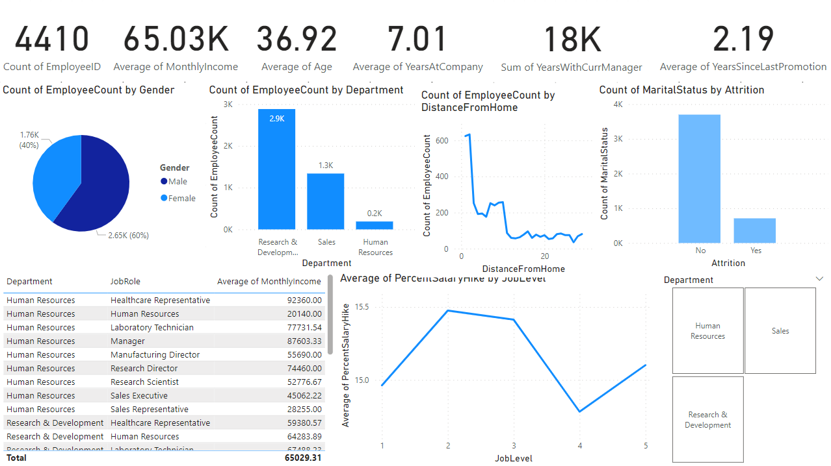
HR DASHBOARD

